Slide 1

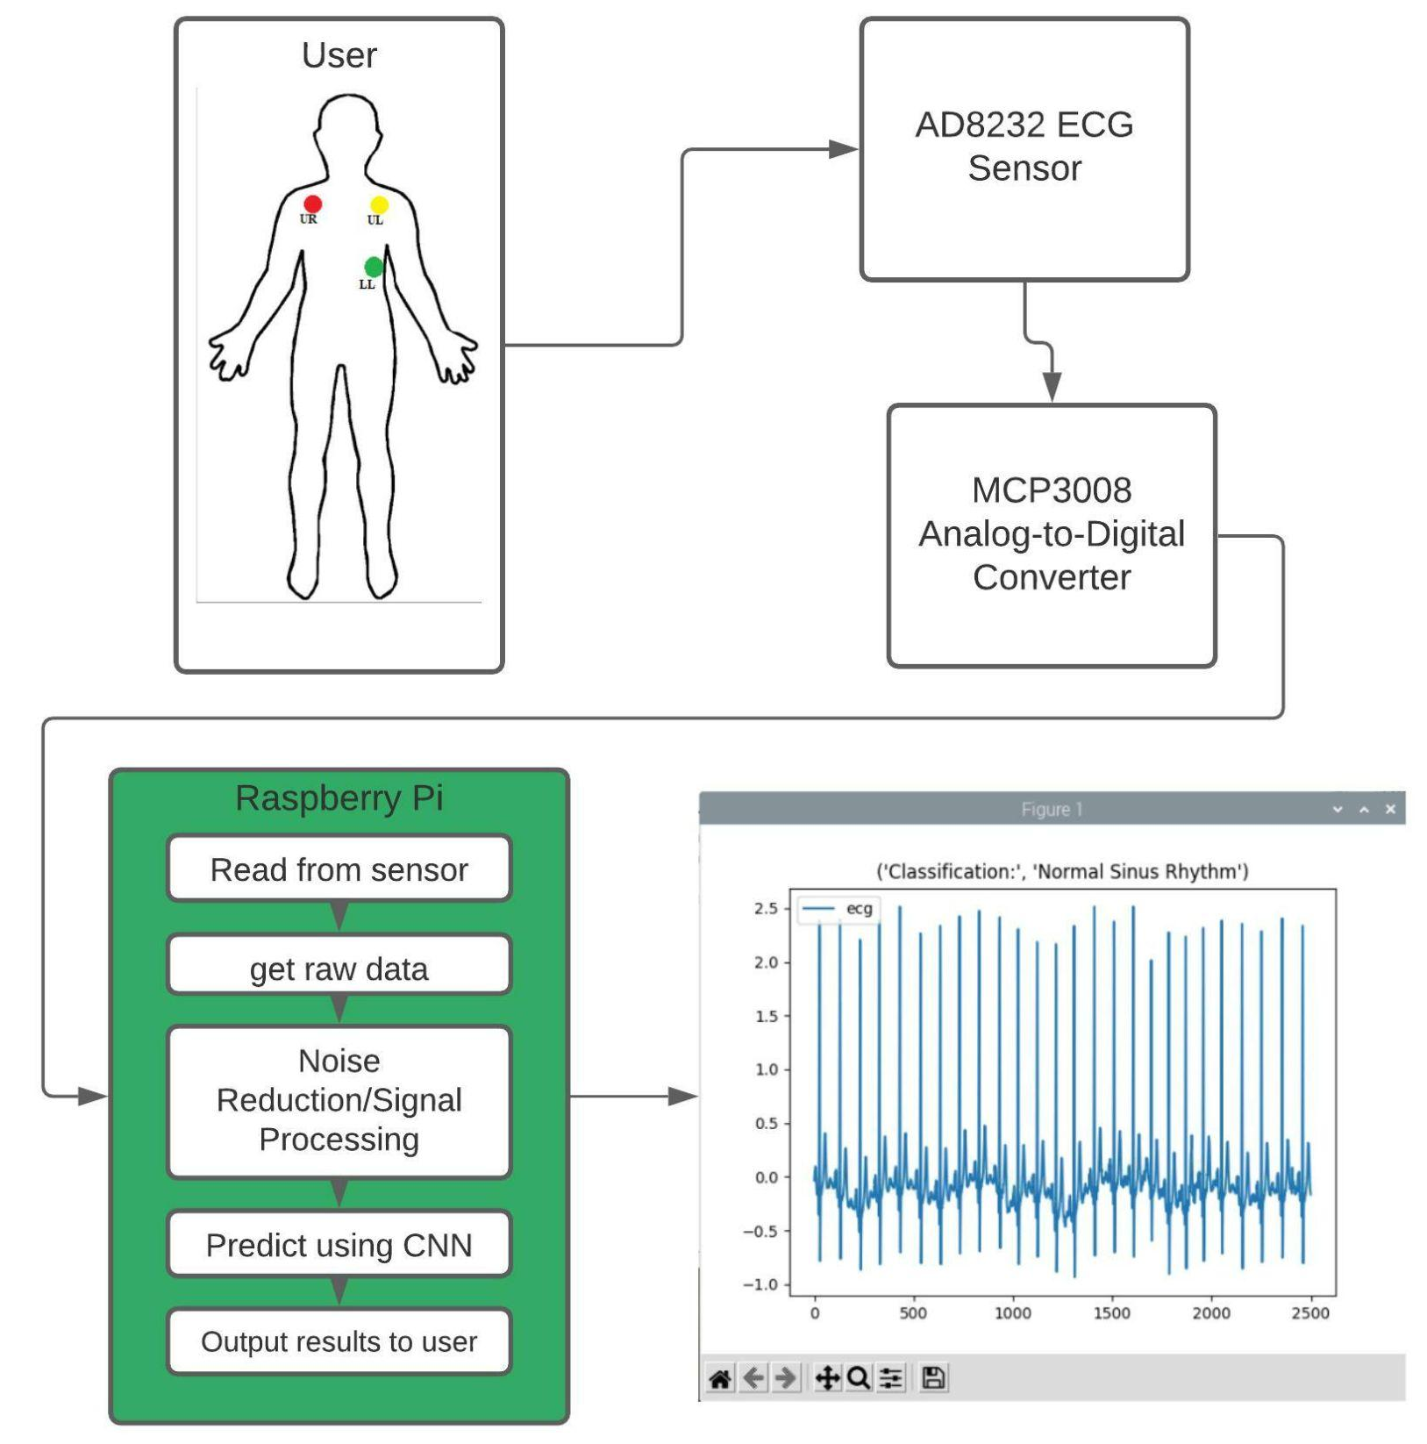
ECG Analysis through Deep Learning and IoT devices
Paul Lussier
Advisor: Prof. Chen-Hsiang (Jones) Yu, Ph.D.
School of Computing and Data Science
Wentworth Institute of Technology
Abstract
Design
Implementation
Discussions
The current standard for catching many heart conditions before they exhibit symptoms is by performing an electrocardiogram. However due to the rising cost of healthcare and the time commitment to get a an ECG has led many to forego the test. Since early detection is so important to the survivability of heart disease we wanted to find a way to both decrease the cost and time commitment of recording an ECG. With the advent of more powerful and cheaper hardware in the IoT space such a solution becomes possible. We trained a convolutional neural network to classify incoming ECG signals as either Normal Sinus Rhythm(NSR), Congestive Heart Failure(CHF) or Atrial Fibrillation(AF). This model, in conjunction with a Raspberry Pi hooked up to an AD8232 ECG sensor is able to provide a user with a real time classification of their heart rhythm without the need for internet or a doctor.
Our system for collecting a user's ECG signal starts with the AD8232 sensor. In order to get a readable signal in the Raspberry Pi a MCP3008 ADC is required to convert the analog output of the AD8232 to a digital one. The MCP3008 output is connected to the Raspberry Pi according to documentation by the creators of the chip. The digital output is read from the SPI pins into a text file, each datapoint getting its own line. All the code for driving the data collection process along with a handful of functions needed to prepare and analyze the data have been compiled into a single python class for ease of recreation.
Data Extraction and Preprocessing: Using Google Colab we extracted data from PhysioBank[1] to train a convolutional neural network that could classify incoming ECG signals into three categories, NSR, CHF, AF. Once the data was imported we ensured that the sample rate was consistent and segmented it into 5000 point chunks before splitting up the data into training and testing splits.
Model Training: The model was constructed in Google Colab using TensorFlow and Keras with three convolutional layers followed by a dropout layer and a global average pooling layer. After the pool we a dense layer followed by another dropout layer and finally the output layer which had a softmax activation function.
Collection and Postprocessing: After hooking up ECG leads like in figure 1, we performed some noise reduction to the data before sending it to the model for final classification.
User Interface: Over the course of this study we created a host of functions and methods for working with ECG data that we compiled into a python library so people hoping to build off of our work can see how we came to our results and easily begin to discover their own.
We found that in real world testing there was discrepancy between the signals received from our system and the data used to train the model. Whether this is a result of the AD8232 only having 3 leads or a setup difference, we would like to test on a wider range of individuals and get a better sense of the capabilities of our model/system in the real world.
Noise reduction algorithms are also a point of future research. We explored a few of the more common techniques, but without a mathematical way to evaluate their performance we can only go off of how they look and what the model classifies the quiet samples as.
Conclusion
Introduction
Using deep learning we created a convolutional neural network capable of classifying an ECG into three categories with 96.93% accuracy. Though we cannot be sure that the real world accuracy is as impressive we can say that when compared to classical machine learning algorithms trained on the same data and evaluated the same way that deep learning has a higher accuracy.
Heart health is often touted as a major area for improvement especially in the United States. The social effects of COVID-19 coupled with the poor diet and exercise habits perpetuated by modern life take tolls in many ways, but few operate as quietly as heart disease. With the advent of reliable consumer grade ECG sensors and the advances in Internet of Things (IoT) computing power the door has been opened to build a device that can read, prepare, and classify a person’s ECG reading at home. Pairing these advancements with a deep learning model trained on a more powerful machine and loaded into the minicomputer could be an even larger leap forward in the space of early detection of heart disease.
Results
After comparing the convolutional neural network’s performance to the model(s) created by Shrestha et. al.[2] We believe that deep learning and in particular convoluted neural networks provide a higher accuracy when evaluated in the same way as classical machine learning techniques.
Bibliography
Goldberger, A., Amaral, L., Glass, L., Hausdorff, J., Ivanov, P. C., Mark, R., ... & Stanley, H. E. (2000). PhysioBank, PhysioToolkit, and PhysioNet: Components of a new research resource for complex physiologic signals. Circulation [Online]. 101 (23), pp. e215–e220.
Shrestha, A., Yu, J., (2021). Remote Heart Monitoring - ECG data analysis using IoT Devices and Machine Learning.
Figure1: Full system flowchart

